Slide 1
Grayson Hotel
June 26, 2020

Slide 2
Development Team (same as Sycamore on Main)
Developer/Owner: Architect: Contractor: Attorney: Environmental: Historic Consultant: Property Manager:
NeighborWorks Housing Solutions Utile
NEI
Klein Hornig McPhail VHB
Trinity Management

Slide 3
Project Overview
Description:
historic rehabilitation and adaptive reuse of the former Grayson Hotel
Program:
16 studio residences with gracious high ceilings and large windows + common amenity space + ground-activating community space (dirty maker/gallery space)
Target:
workforce housing attractive to creative urbanites ($1,000 / month rent)
Result:
upon completion, the Grayson (16 units) and Sycamore on Main (48 units) will be owned and operated by NeighborWorks as a unified 64-unit residential community
Notes:
Presenter
2020-06-26 06:14:05
--------------------------------------------
Brockton Networking Expo

Slide 4
Project Goals
Rejuvenate an architectural gem
Activate Frederick Douglass by breathing new life into a long vacant building
Introduce new “eyes on the street”
Demonstrate investment EVERYWHERE in Downtown -- from large-scale to smaller infill sites
Beautify the fulcrum of Downtown’s emerging “Green Ribbon” (the Grayson’s front- and back-doors)

Slide 5
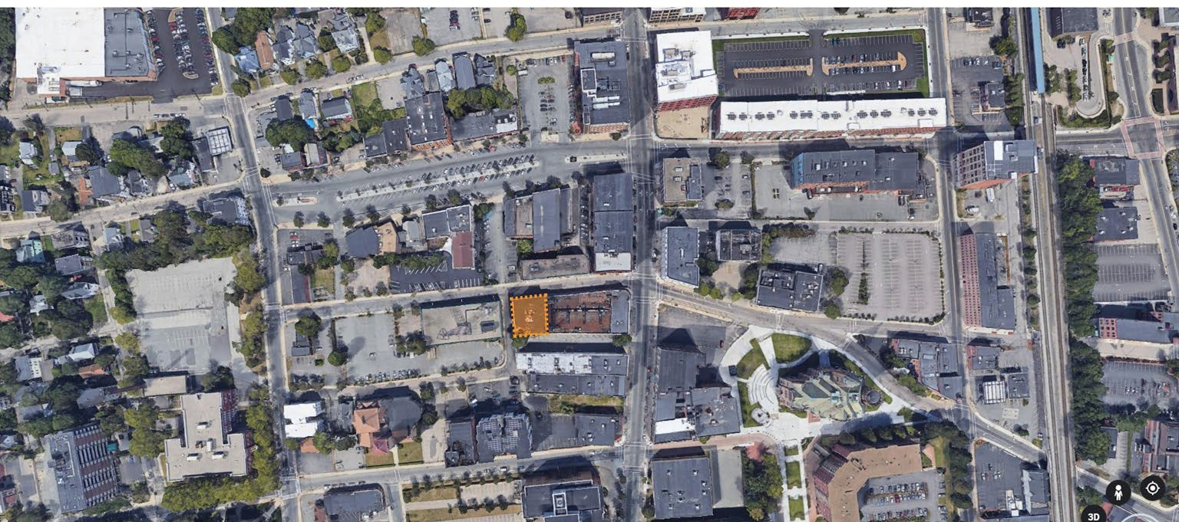
Neighborhood Context

Slide 6
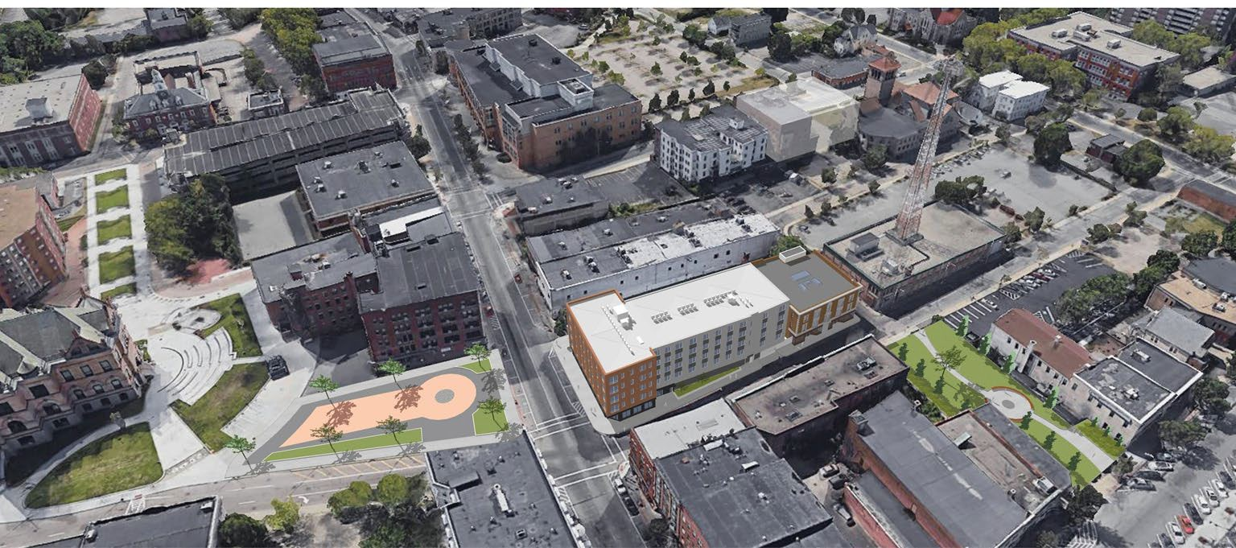
Aerial

Slide 7
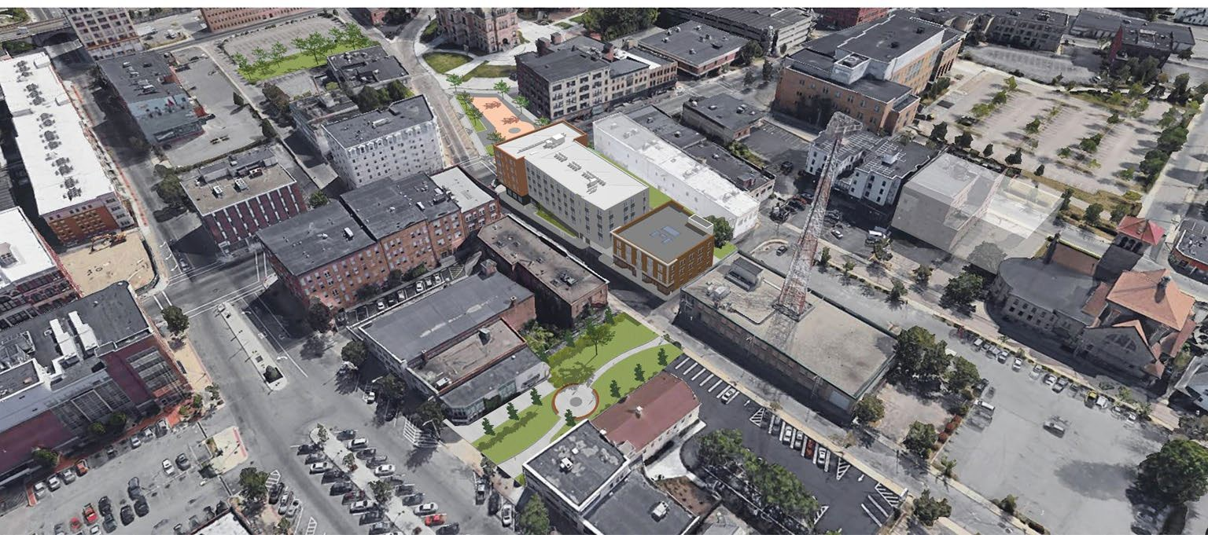
Aerial

Slide 8
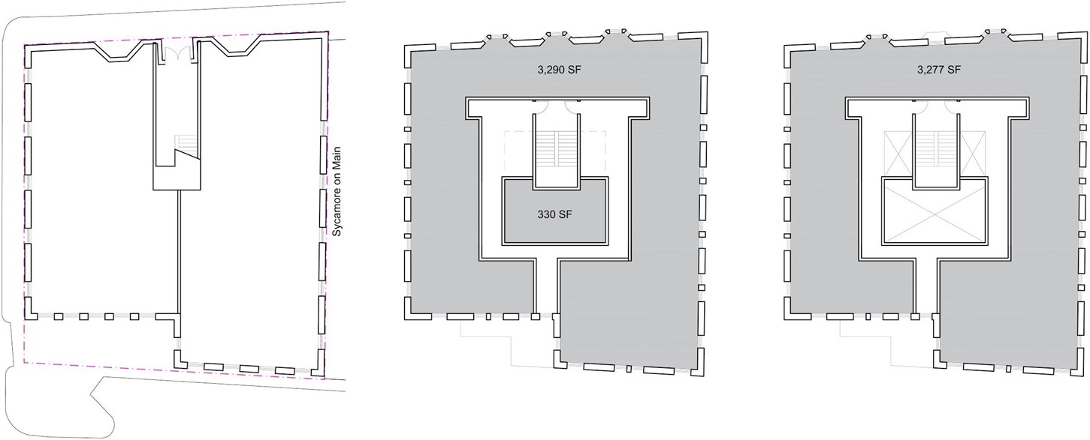
Existing Conditions
Ground Floor: 5,122 SF
Second Floor: 5,244 SF
Grayson Hotel
Third Floor: 4,759 SF

Slide 9
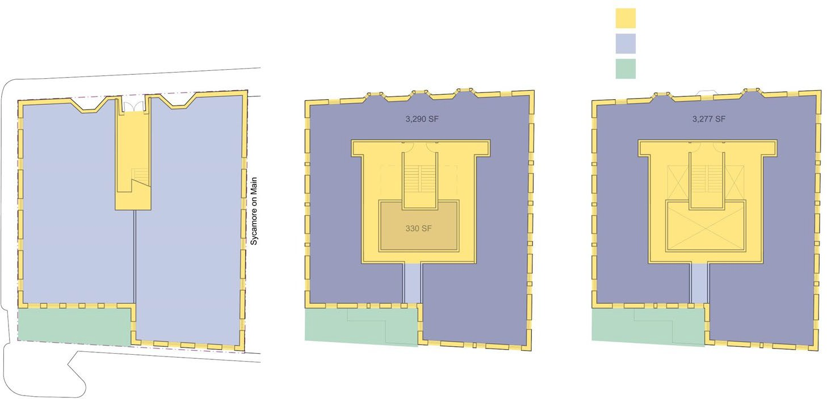
Preservation/Renovation Approach
Rehab/restore Gut renovate New construction
Ground Floor: 5,122 SF
Second Floor: 5,244 SF
Grayson Hotel
Third Floor: 4,759 SF

Slide 10
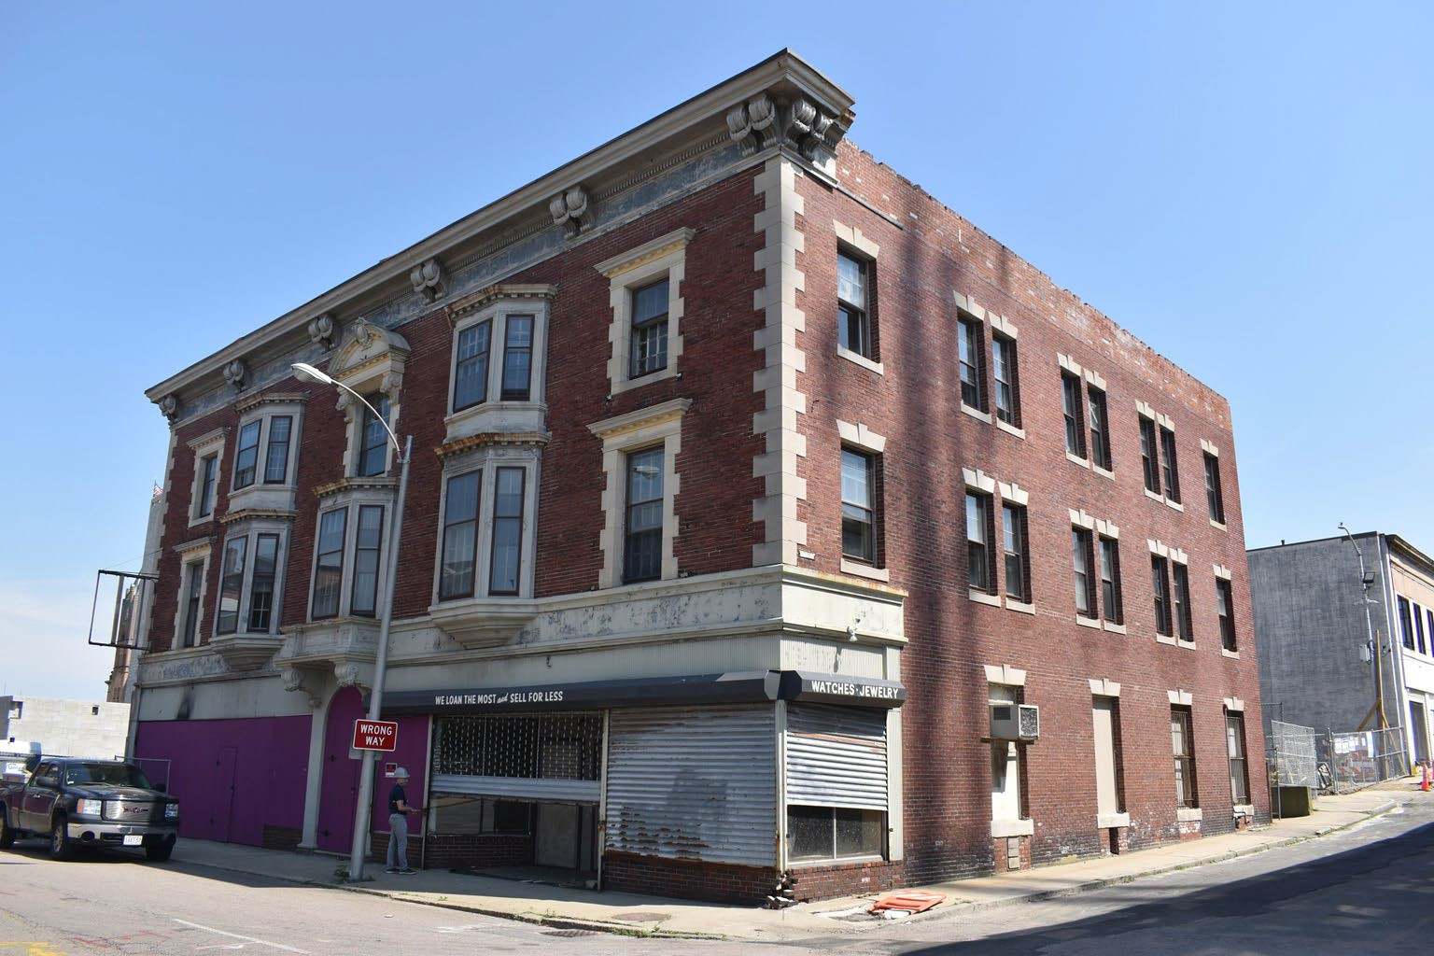
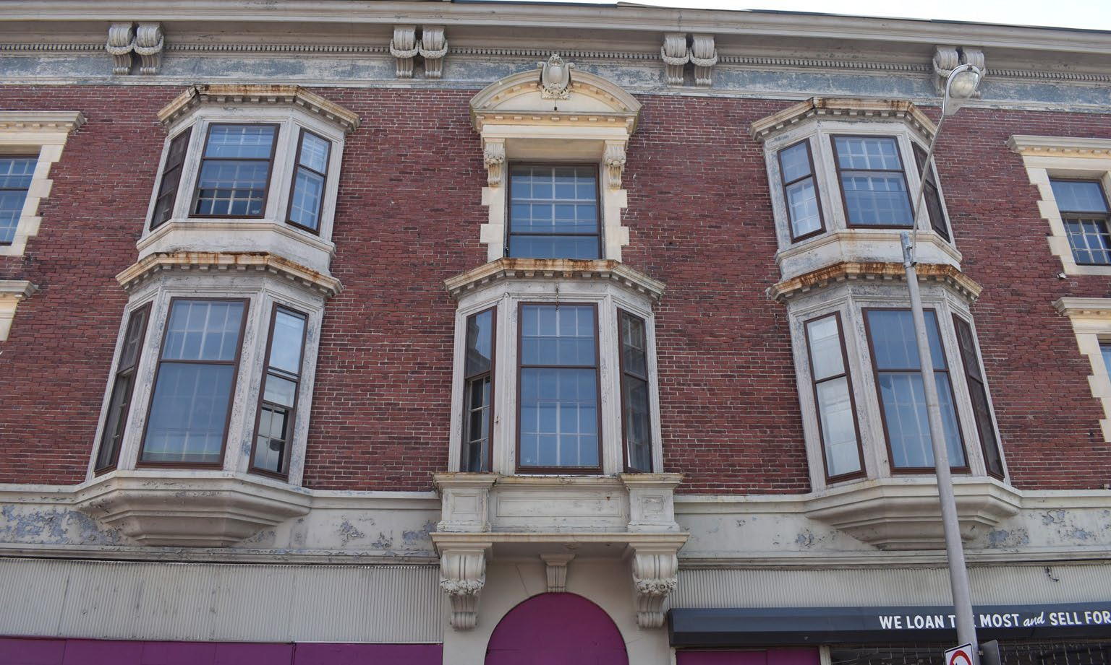
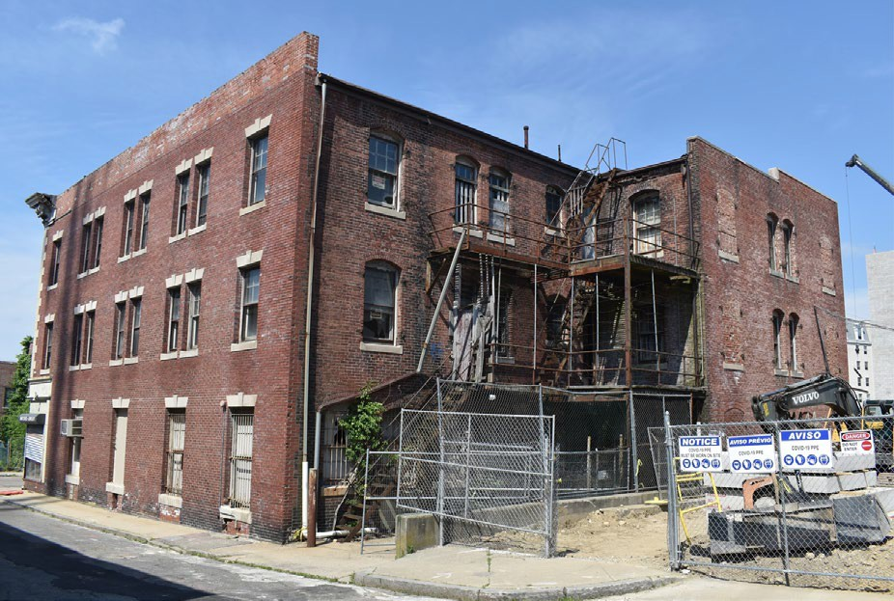
Exterior Existing Conditions
Opportunity to Revive an Architectural Gem
Restore/Repair masonry facades and cast stone details
Preserve historic elevation along Frederick Douglass Ave.
Rebuild ground level storefront to historic standards
Restore/Replace broken/covered windows on sides/rear
Utilize existing fire escape space for new stair/elevator

Slide 11
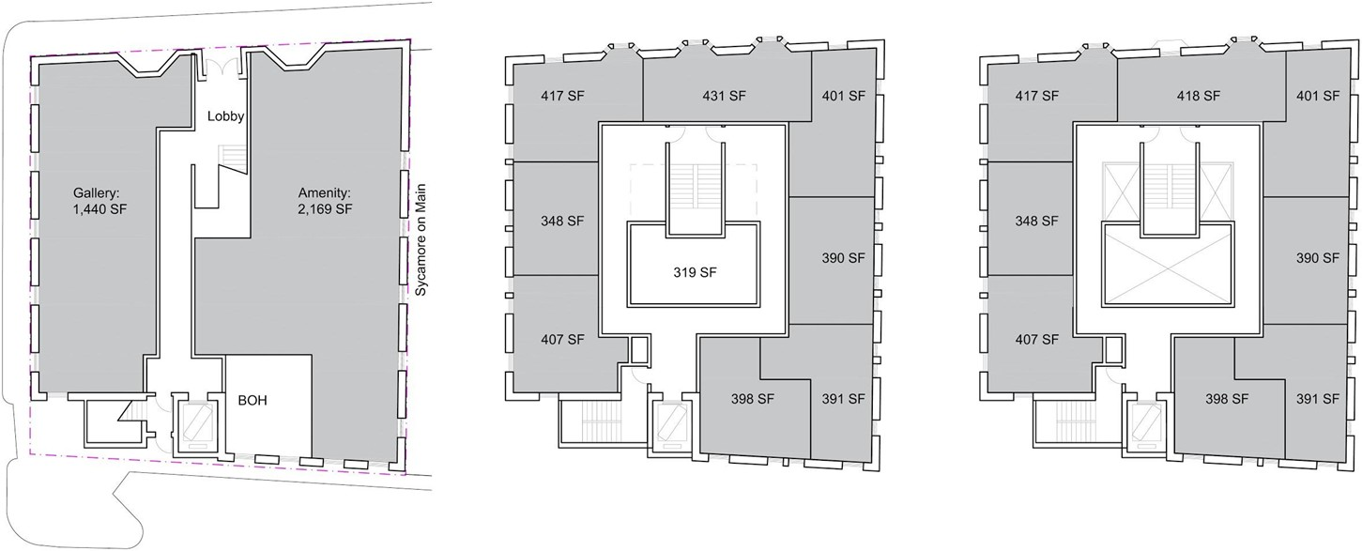
Proposed
Ground Floor: 5,366 GSF
Second Floor: 5,487 GSF
Third Floor: 5,002 GSF

Slide 12
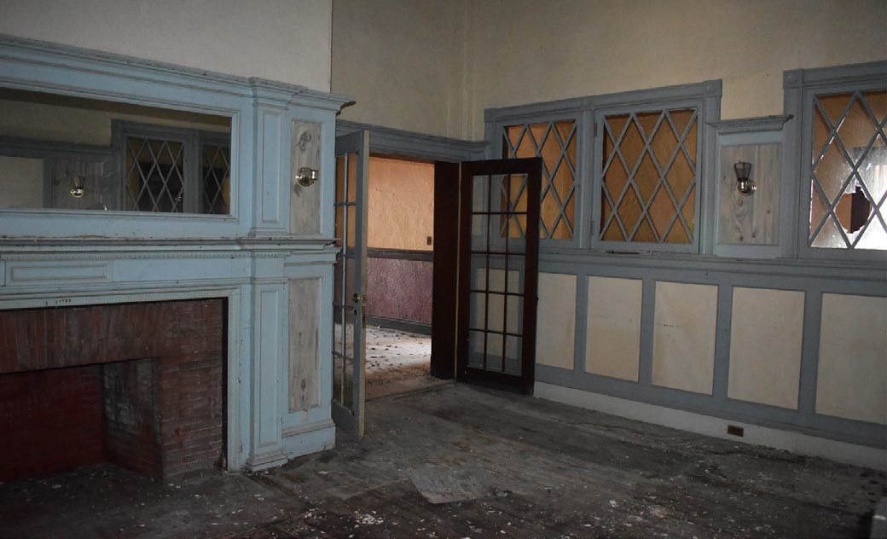
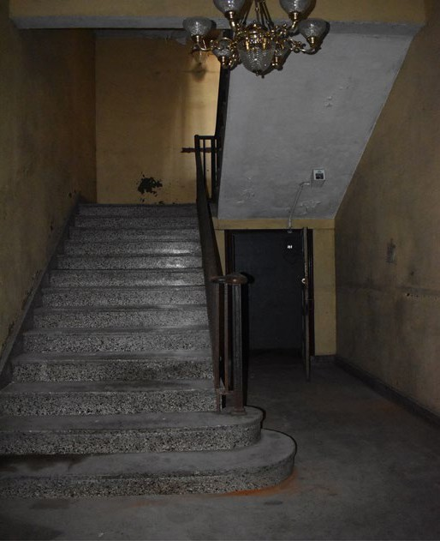
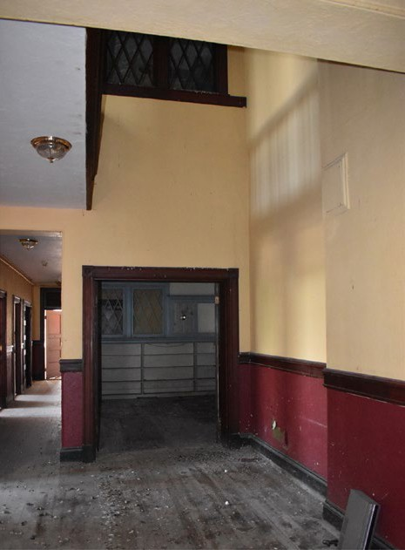
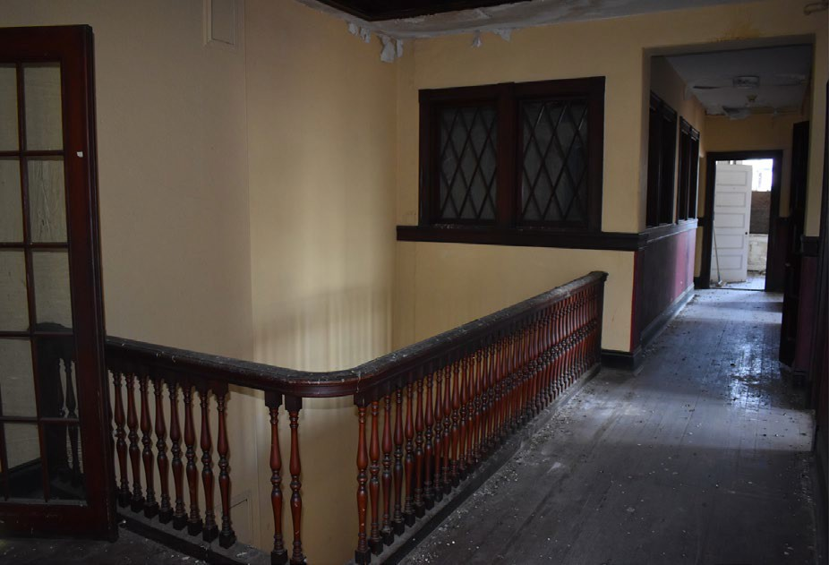
Interior Existing Conditions
Opportunity to Revive an Architectural Gem
Restore central stair, double-height library, corridors and skylights
Maintain historical character at common areas
Gut renovate hotel rooms at perimeter to create new studio apartments

Slide 13
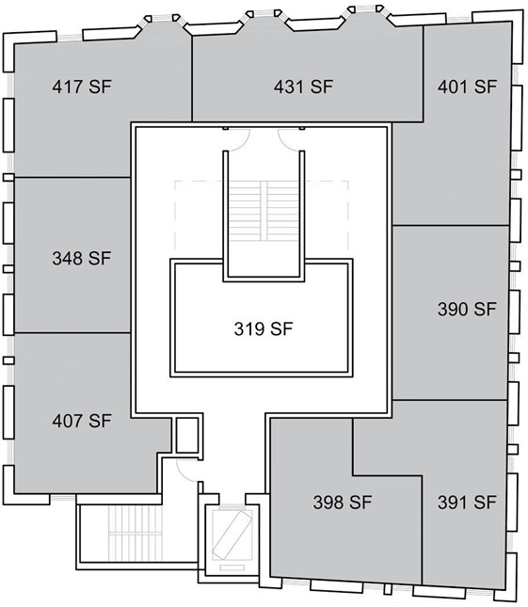
Typical Floor
Project Stats
16 Studio Apartments 15,855 GSF Total Area
6,334 Net SF Residential Area
3,609 SF Community/Commercial Area 320 SF Private Amenity space (Ex. Library)
New Elevator and Egress stair serving residential levels
Upgraded building systems and life safety measures

Slide 14
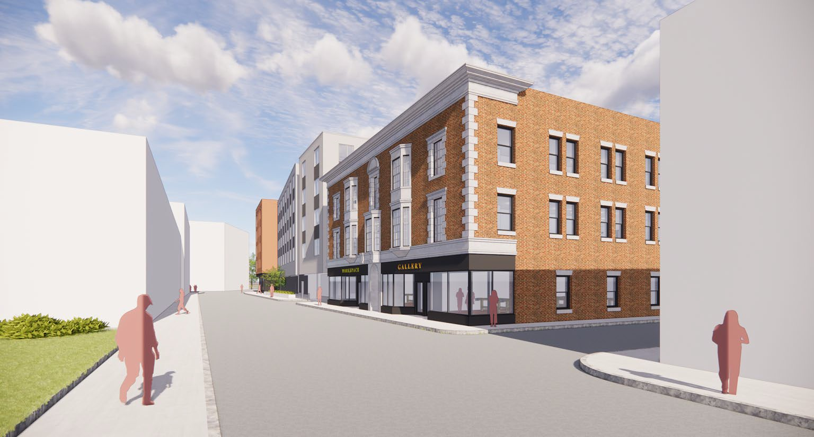
Frederick Douglass View

Slide 15
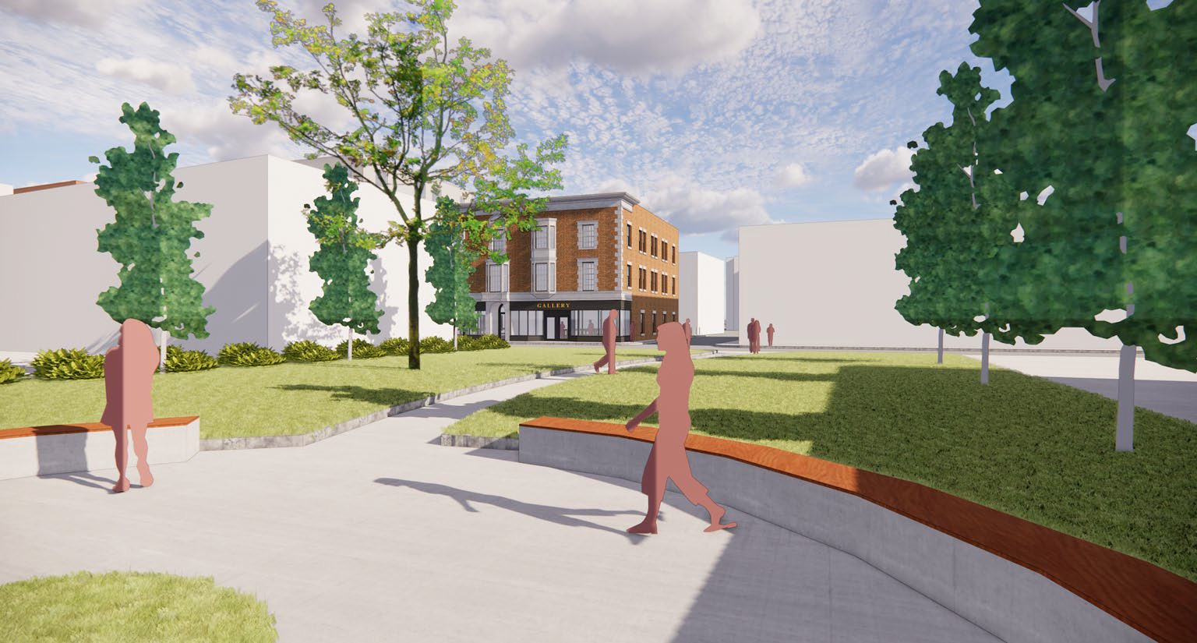
Park View

Slide 16
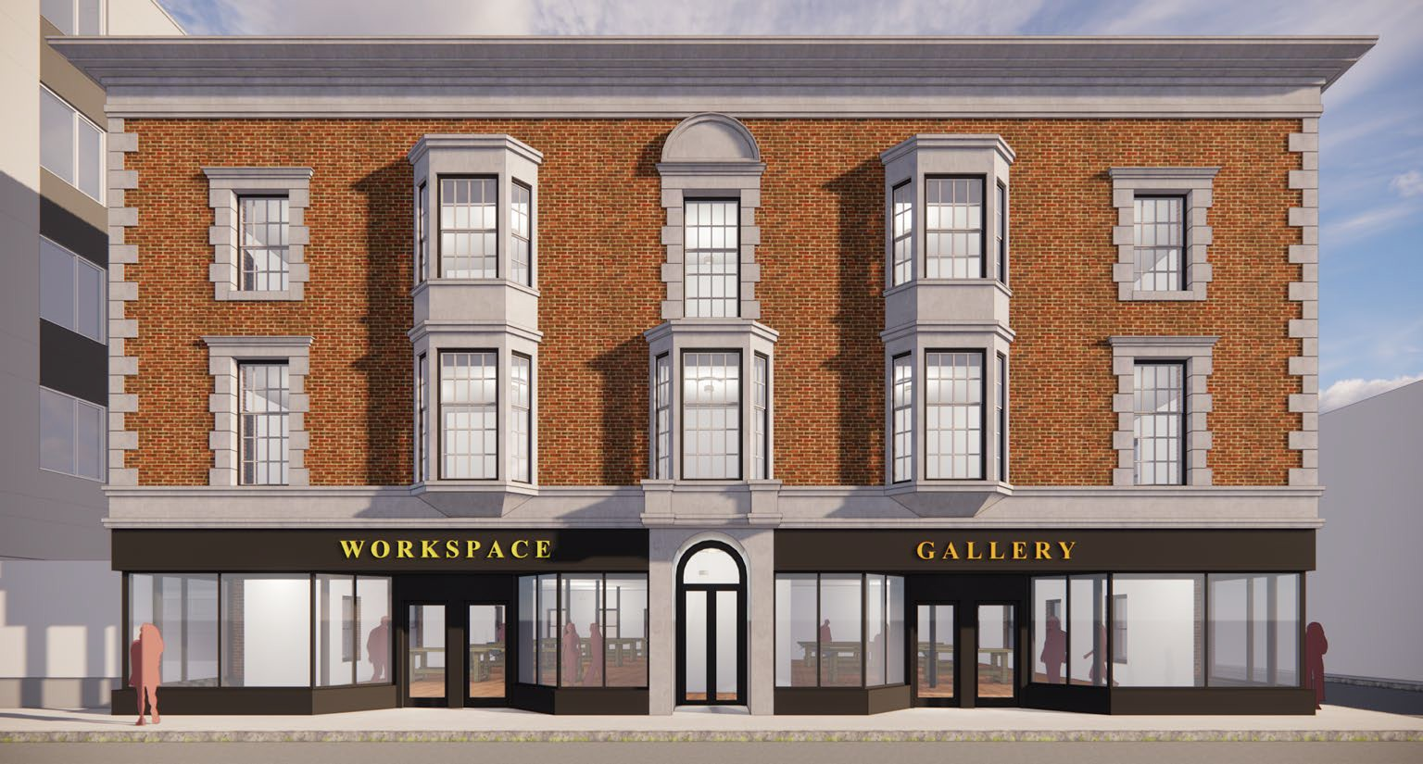
Street View

Slide 17
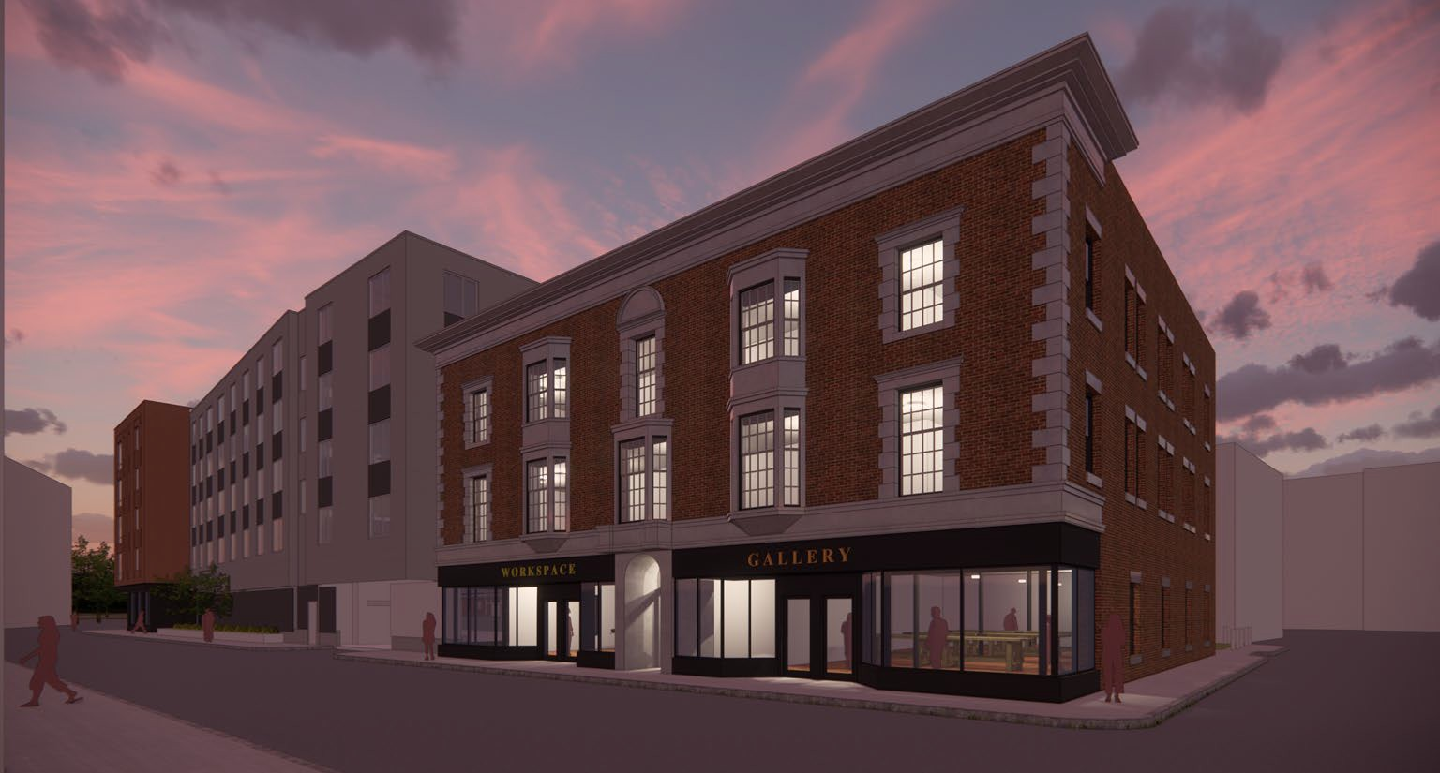
Evening View

Slide 18
Thank You!
25

